Slide 1

tellar Robotics Presents: java and robots! Part 1

Slide 2

Agenda
What Is Java
Syntax
Variables and Arrays
Conditional Statements
Loops
Functions
Guessing Game

Slide 3
What Is Java?

Slide 4
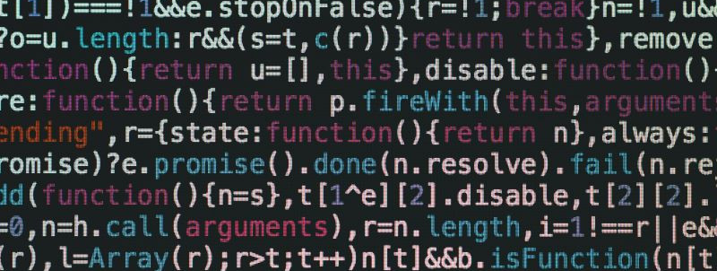
Syntax… What does that even mean?

Slide 5
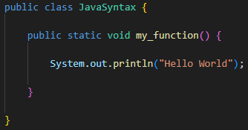
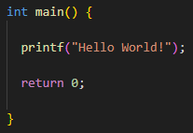
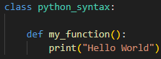

Slide 6
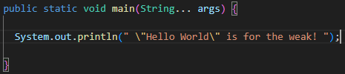
Finally, We Get to write a program!

Slide 7
Variables and Arrays
Don’t fret, they’re a lot easier than in algebra.

Slide 8

The Fundamental variable
A Variable…
Is a digital container that you can put data in.
Allows you to reference the same data in multiple parts of your code.
Can contain different types of data.
Allows for the data in it to change (it varies).
“I live in a box”
My Variable

Slide 9
Variables in java
Name of the variable (usually camel case)
String myVariable = “This box is cramped” ;
Contents of the variable
Type of data the variable will store
End of statement

Slide 10
Arrays
Curly brackets define the beginning and end of the array structure
String[] myArray = {“Logo", "BMW", “Chalk"} ;
Square brackets are put on the end of the data type to tell Java that the variable contains an array
Commas separate each element in the array

Slide 11
Conditional Statements and loops
Enable your code to make decisions.

Slide 12
If Statements
If Statements allow code to run when a condition is met and vice versa.
Your 1000% Crazy
True
Then are birds real?
True
False
Is the Earth Flat?
Your Mostly Crazy
False
Your just wrong!

Slide 13
IF Statements in java
A conditional expression is put inside the pair of parenthesis
If (1 + 1 == 2) {
System.out.println(“Perfect Harmony”);
}
else {
System.out.println(“World Explodes”);
}
Code inside the curly brackets is only run if the condition is true
“Else” blocks can be put after the “If” block. The “Else” block will run if the condition in the “if” block is NOT true”

Slide 14
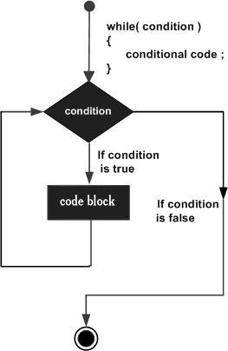
Loops (while loops)
Just like “if” statements, we put a conditional expression inside the parentheses
while (annoying == true) {
imNotTouchingYou();
}

Slide 15
Functions
Make your code modular and reusable

Slide 16


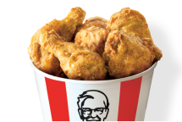
Functions
Functions are blocks of code that accomplish a specific task.
Functions can be called multiple times in your code
fastFoodFryer(chicken, motorOil);

Slide 17
Functions in java
The type of data the function returns
The input the function requires
int addFive(int inputNumber) {
return inputNumber + 5;
}
We are passing "myNumber" to the function when we call it.
The result will be the sum of the number we pass in and 5
int result;
int myNumber = 3;
result = addFive(myNumber);

Slide 18
Guessing Game

Slide 19
That’s all
If you'd like to review the concepts we covered in part 1 again, you can visit www.fuzzlabs.net for a quick refresher.

